Slide 1
Introduction to natural organic matter characterization with ultra-high resolution mass spectrometry
Will Kew
Chemist
william.kew@pnnl.gov
November 7th, 2023

Slide 2
Overview
What is High Resolution Mass Spectrometry?
Typical Experimental Workflow
Case Studies

Slide 3
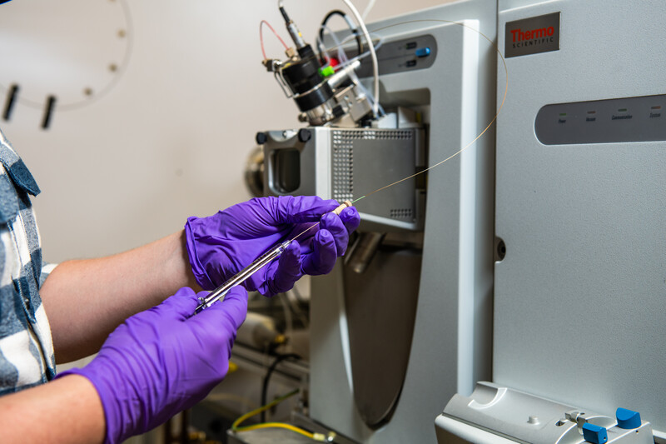
What is Mass Spectrometry?
Mass Spectrometry – measuring the mass of molecules
Technically, the ‘mass-to-charge’ ratio (m/z) of ions
Molecules are converted to gas phase ions for analysis
Electrospray Ionization (ESI)
Matrix Assisted Laser Desorption Ionization (MALDI)
Electron Ionization (EI)
Each ionization method has different biases and properties
Mass spectrometers have many types
Single quadrupoles, triple quadrupoles
Time-of-flight (TOF)
Magnetic Sector
FTMS – Orbitrap or Ion Cyclotron Resonance (ICR)
Liquid sample being infused into an ESI source

Slide 4
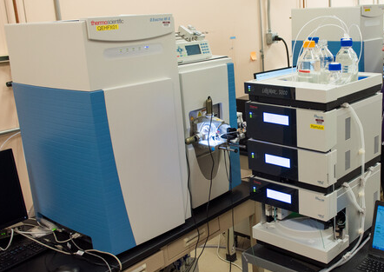
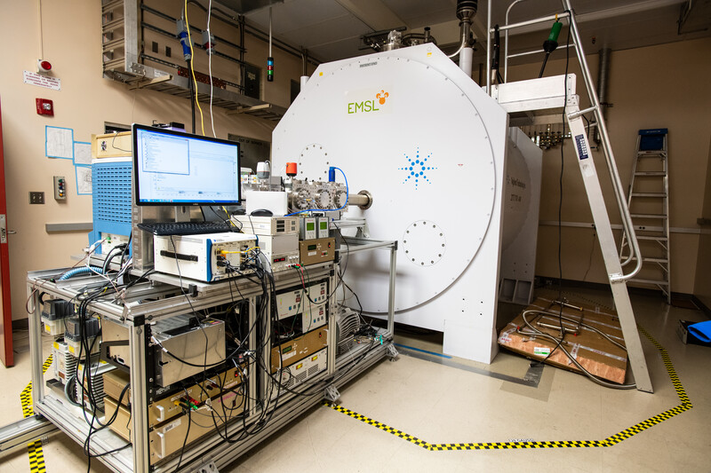
What is High Resolution Mass Spectrometry?
High resolution mass spectrometry (HRMS) resolves isobaric compounds
Molecules with the same nominal (integer) mass
e.g. C₁₆H₁₈O₁₀ and C₁₃H₂₂O₁₂
370.08997 vs 370.11113 – mass difference of just 0.021 Daltons, or 21 mDa
HRMS includes Orbitrap and ICR MS – two types of Fourier transform MS (FTMS)
EMSL 21 Tesla FTICR MS
LC-MS (Orbitrap)

Slide 5
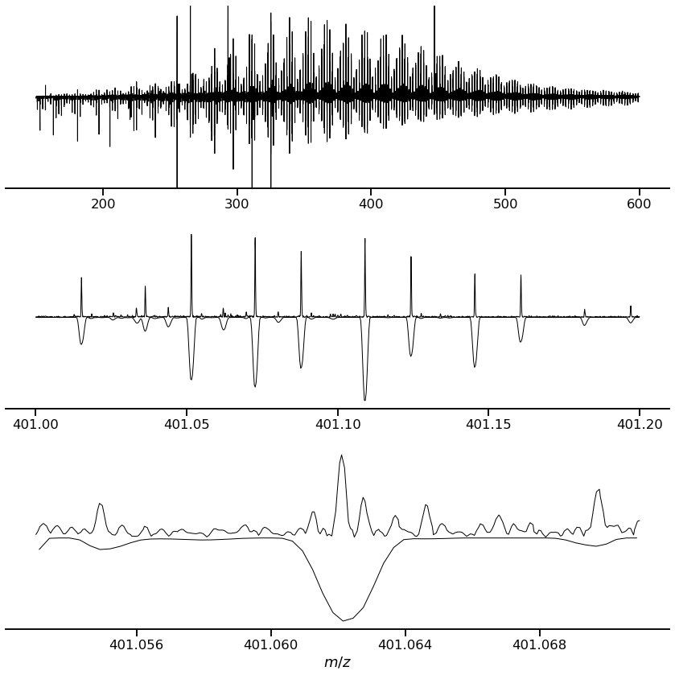
How High is High Resolution?
7T ICR
Top shows spectrum acquired with 7T FTICR
Bottom shows spectrum acquired with Orbitrap (Exploris 480)
Sample is Suwanee River Fulvic Acid
Orbitrap
Each peak represents a measured exact mass
>20,000 peaks detected in this 7T spectrum
Dozens of peaks at each nominal (integer) m/z value

Slide 6
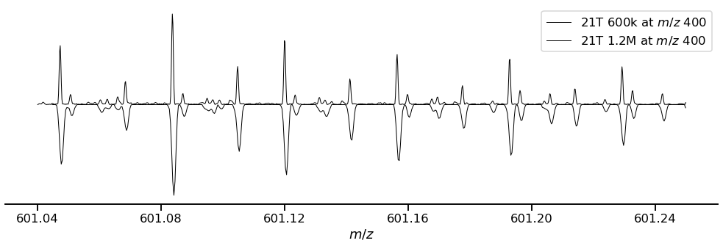
Ultra High Resolution with 21 Tesla FTICR MS
C₂₇H₂₂O₁₆, mma 13ppb
C₂₄H₂₆O₁₆S, mma 24ppb
Over 100 peaks at nominal mass 601
Two features resolved despite being only 3.3mDa apart, and formula assigned with ultra high mass accuracy
mma = mass measurement accuracy (ppm or ppb)

Slide 7
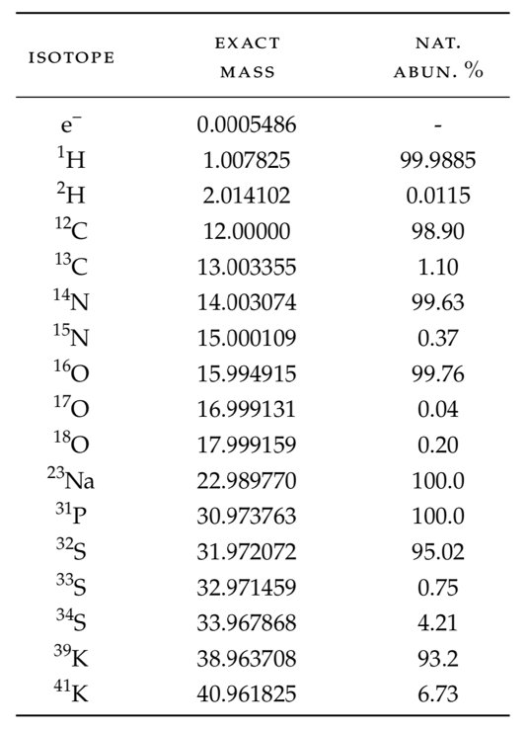
What is High Resolution Mass Spectrometry?
How do you get molecular formula from exact masses?
All isotopes have a unique exact mass
The mass defect is difference from integer (nominal) mass
Combinatorial calculation – with assumptions – allows us to annotate molecular formula to exact masses
e.g. mass of 380.0744 = C₁₇H₁₆O₁₀

Slide 8








Molecular formulas are not structures!
All of these are C₁₇H₁₆O₁₀
A single chemical formula can be multiple structural or stereoisomers

Slide 9
Typical Experimental Workflow FTICR MS for NOM Characterization

Slide 10
Typical Experimental Workflow
Experiment Design
Sites
Sampling and Sample Preparation
Coring
FTICR MS Measurement
Ionization Mode
Raw Data Processing
Data Analysis and Interpretation
Conditions
Hypothesis
Sample Numbers
Replicates
Filtering
Wet or Dry Storage
Anoxic?
Desalting (Solid Phase Extraction SPE)
Solvent Extraction
Direct infusion or online LC?
Instruments
Acquisition Settings (Resolution, Sensitivity, Mass range)
Signal Processing
Peak Picking
Mass Recalibration
Formula Assignment
Spectrum Metrics
Stoichiometric Metrics
Visualization
Peak Intensity Data
Biogeochemical Contextualization

Slide 11
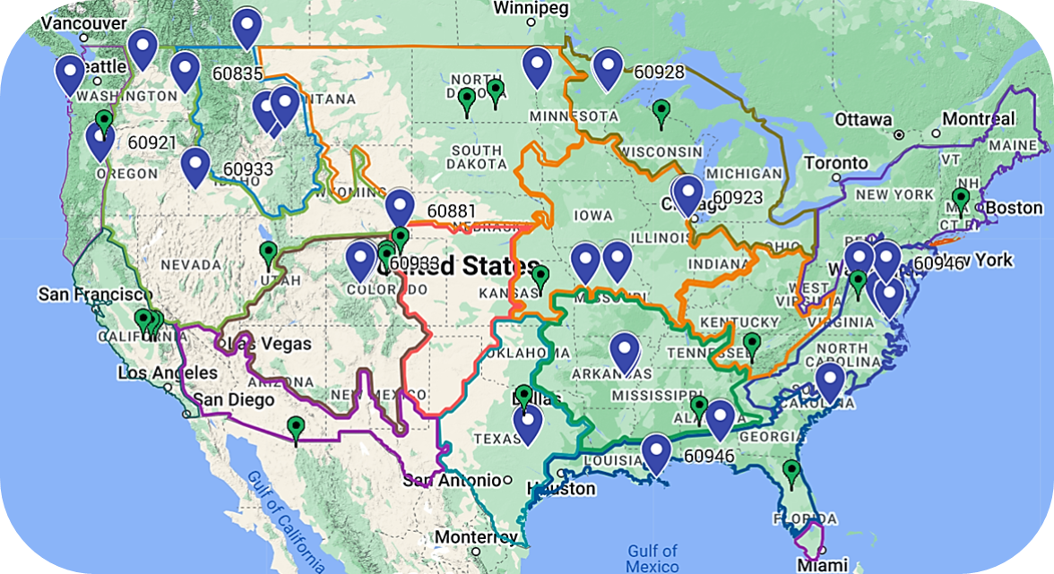
Typical Experimental Workflow – Experiment Design
Which sites?
Soil types, agricultural, NEON, geology
What conditions?
Time series
Seasonal
Intervention – Crop rotation, irrigation
Irregular event – fire, flood, drought
Hypothesis
“Does drought change the nature of bioavailable soil C?”
“Does biomass burning change the composition of organic N in soils?
Sample Numbers and Replicates
‘Biological’ – i.e. field/condition replicates
‘Technical’ – i.e. sample processing/measurement replicate
MS can have batch, drift, and run-order effects
Rich data (1000s of features) means statistical power analysis is important!
MONet Sites To Date

Slide 12
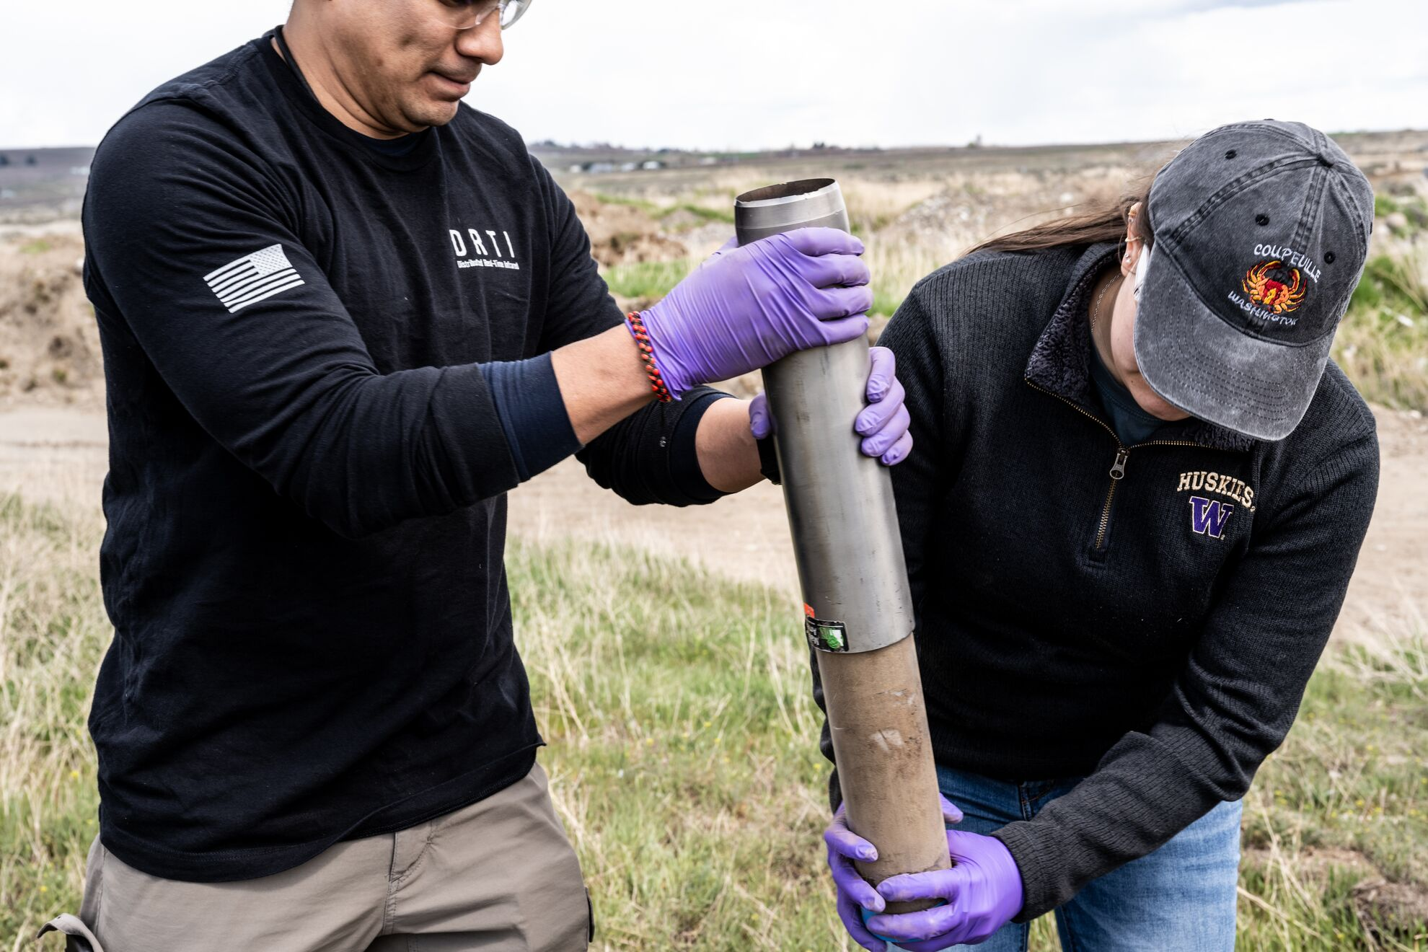
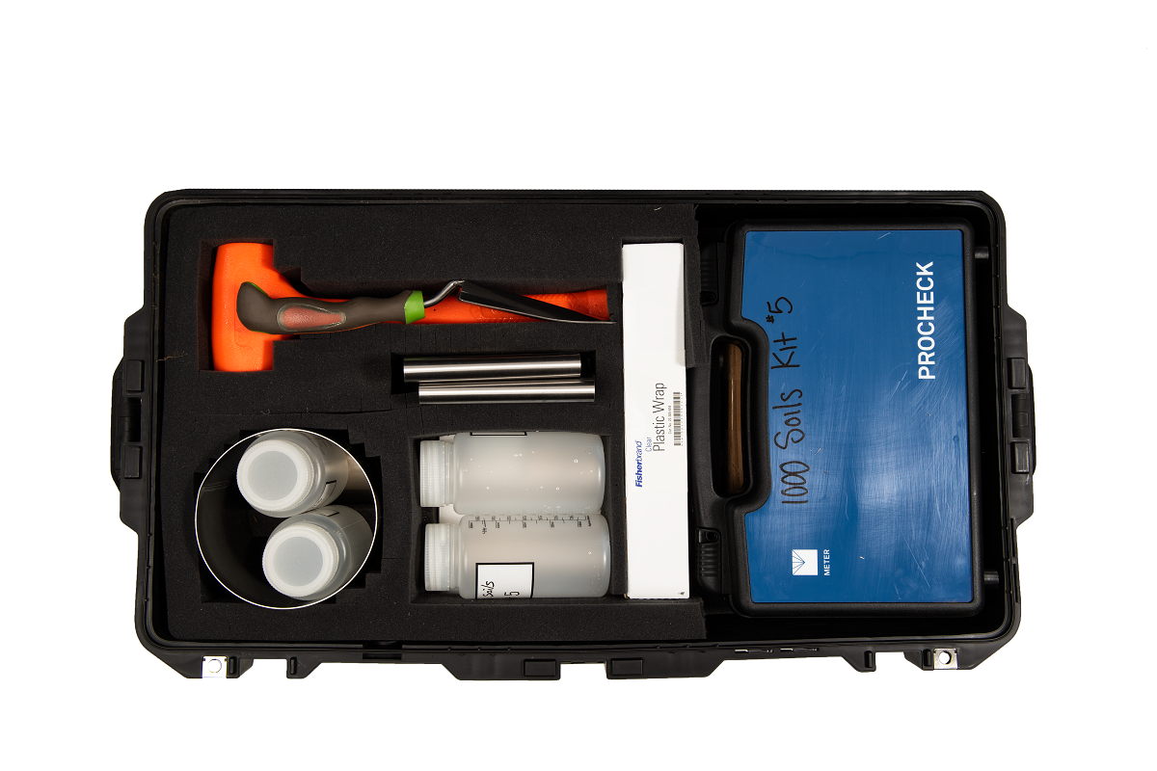

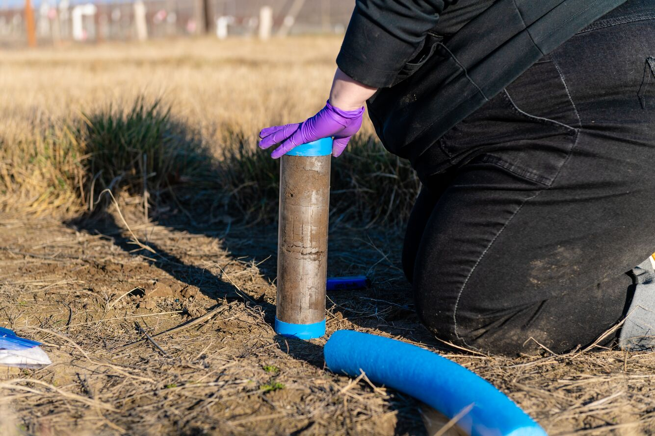
Typical Experimental Workflow – Sampling

Slide 13
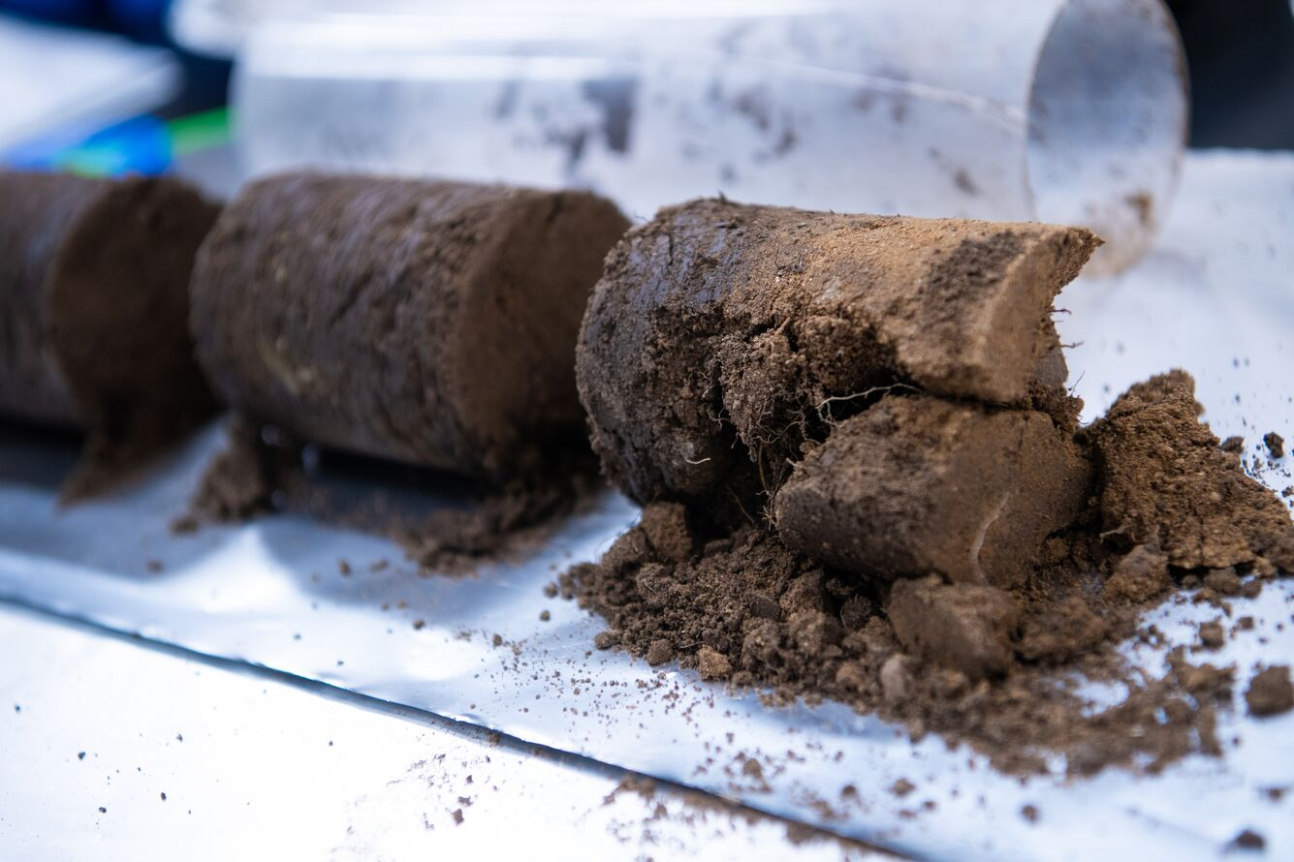
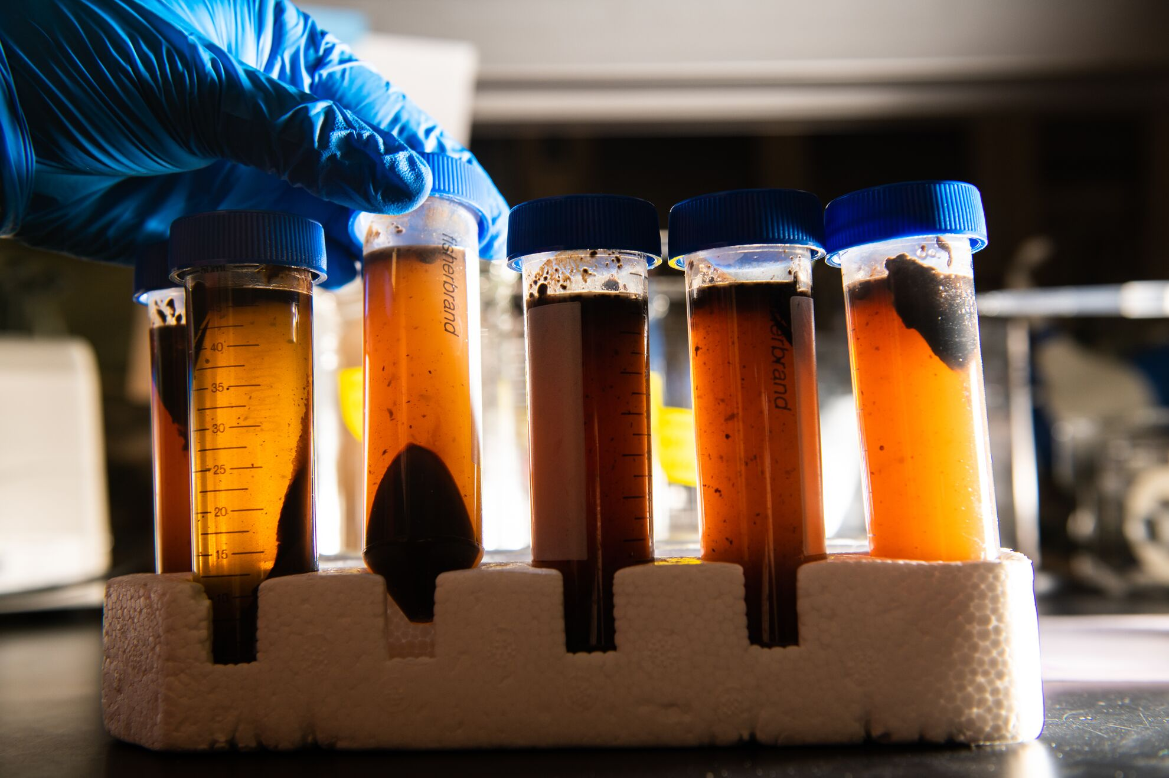
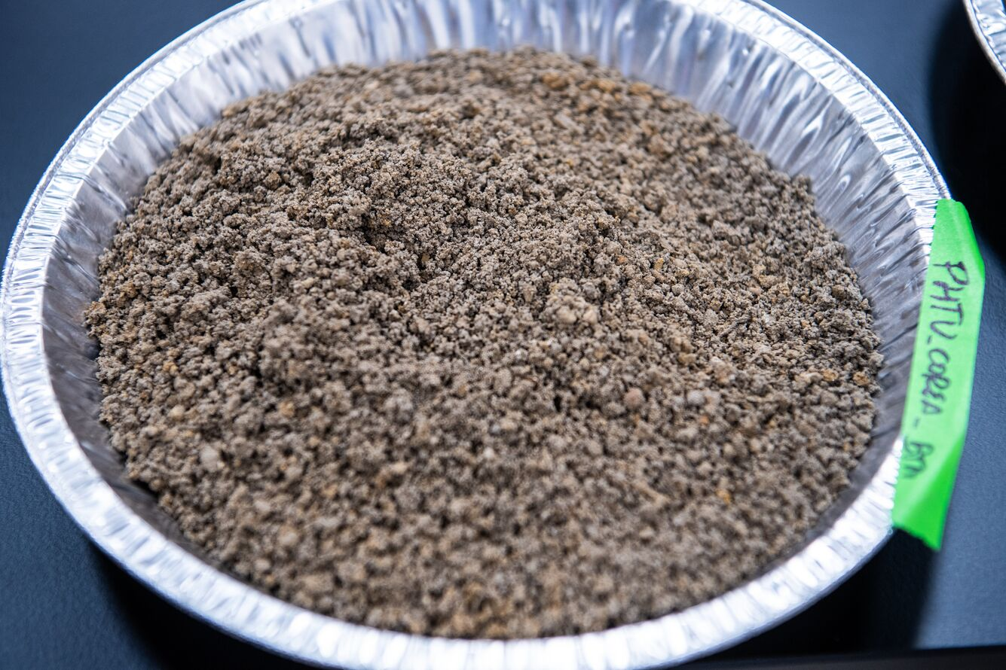
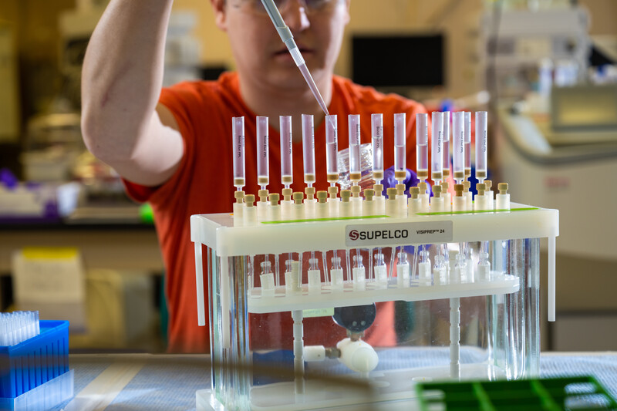
Typical Experimental Workflow – Sample Preparation
Cores are split into sections
Samples are extracted with water
Sections are sieved and air-dried
Extracts are cleaned up by (SPE)
Solid Phase Extraction

Slide 14
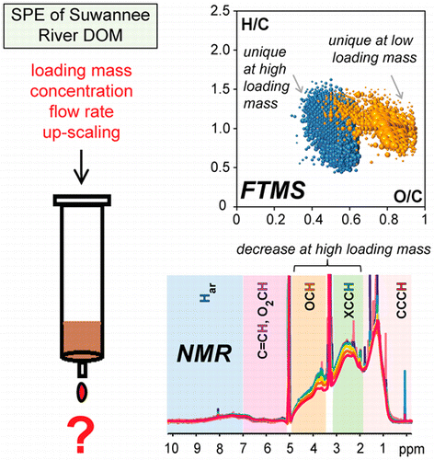
Typical Experimental Workflow – Sample Preparation
For ESI-FTICR MS we need samples in the solution state
Fully dissolved – no particles!
Correct concentration
Not too high – carryover, contamination
Not too low – poor signal-to-noise
Typically, 10-50 ppm (mg/L)
MS is sensitive to salts
Many soils have high mineral content
Some extraction solvents add to salt level
e.g. HCl, NaOH extractions
Desalting can be critical!
Typically, we use solid phase extraction (SPE) to filter, concentrate, and cleanup our samples
Yan Li et al. Analytical Chemistry 2016 88 (13), 6680-6688
DOI: 10.1021/acs.analchem.5b04501
Limnol. Oceanogr.: Methods 6, 2008, 230–235

Slide 15
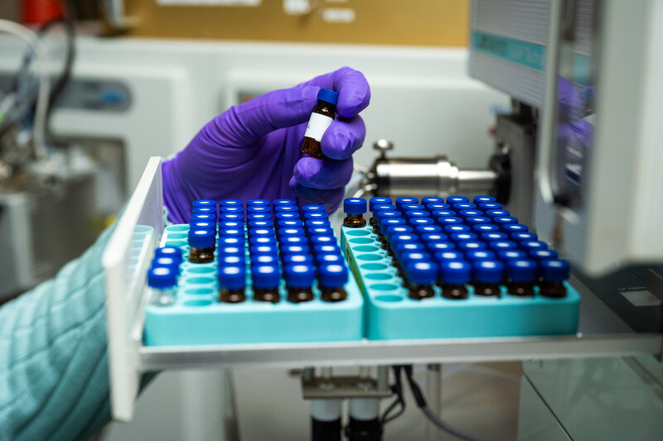
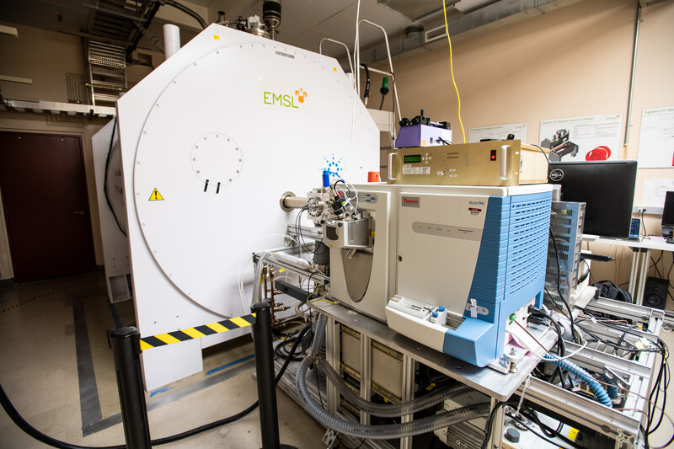
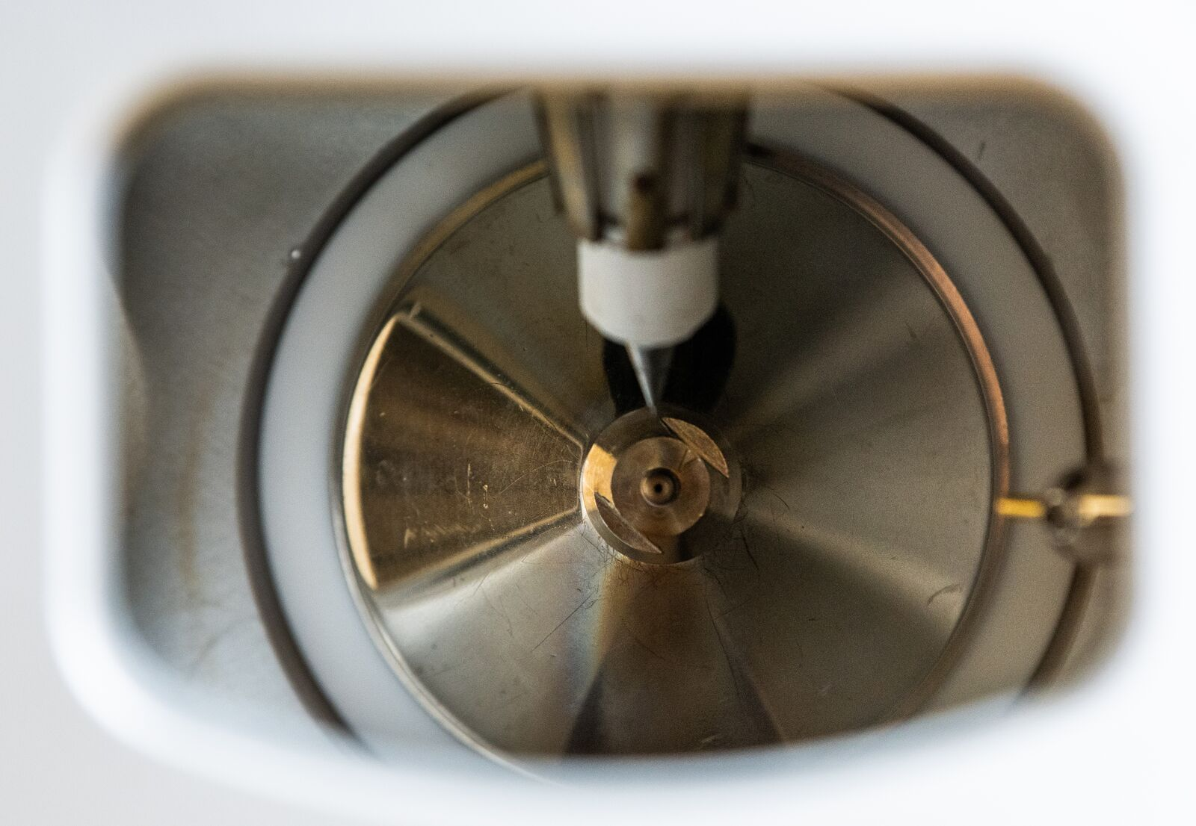
Typical Experimental Workflow – FTICR MS Measurement
Typical measurement time – 25 mins
Typical sample usage – 55 µL at 20 mg/L
Only using ~1 µg per measurement

Slide 16

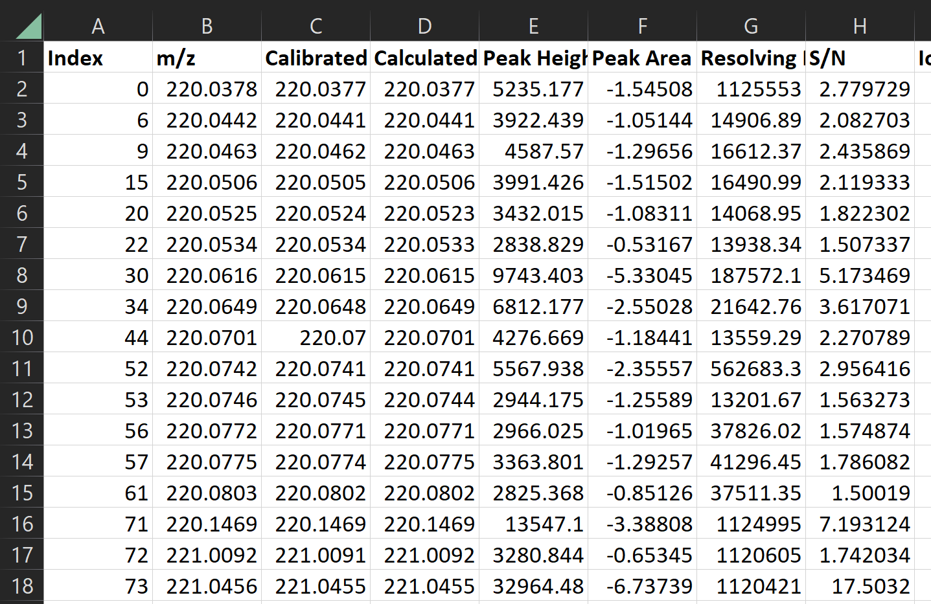
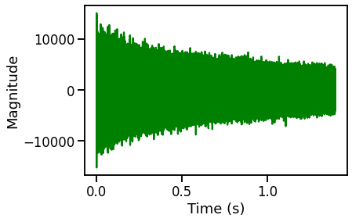
Typical Experimental Workflow – Raw Data Processing
Raw Data from Instrument
Table of peaks, masses, assignments and properties
Automated
Signal processing
Peak picking
Mass recalibration
Formula assignment

Slide 17
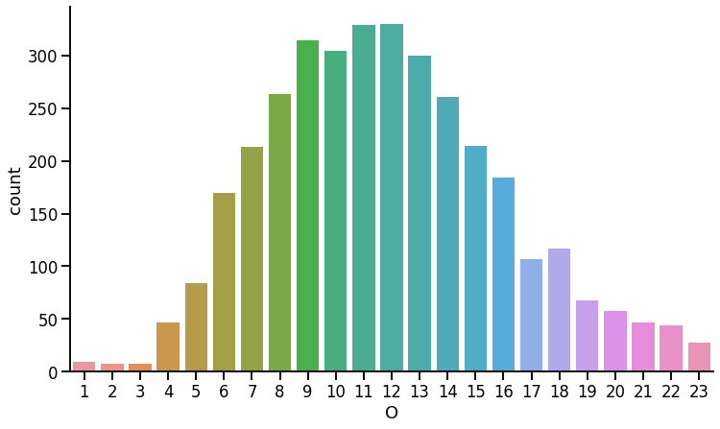
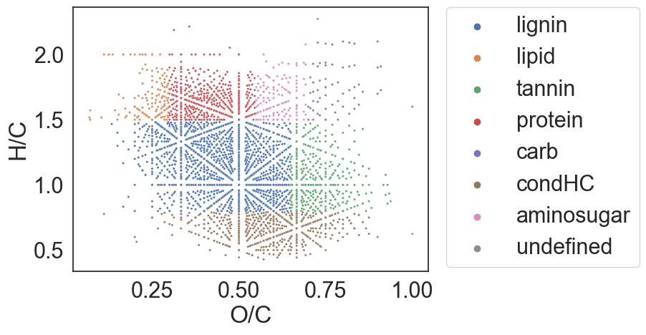

Typical Experimental Workflow – Data Analysis and Interpretation
m/z 195.08765
m/z
[C₈H₁₀N₄O₂ + H]⁺
Stoichiometric Analysis
H/C = 1.25
O/C = 0.25
DBE = 8
AI_{mod} = 0
NOSC = 0.75
Caffeine

Slide 18
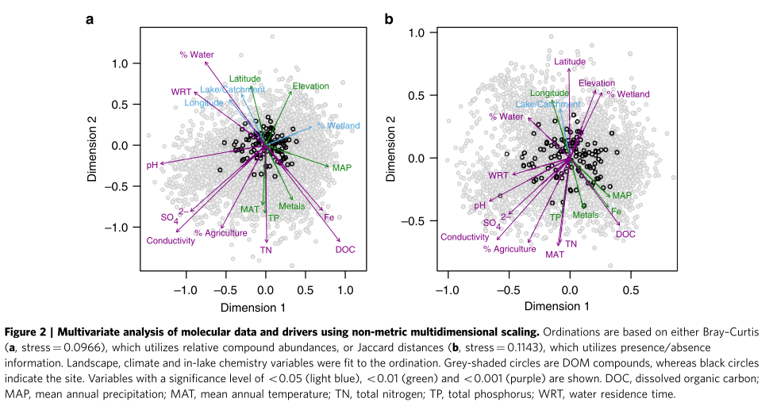
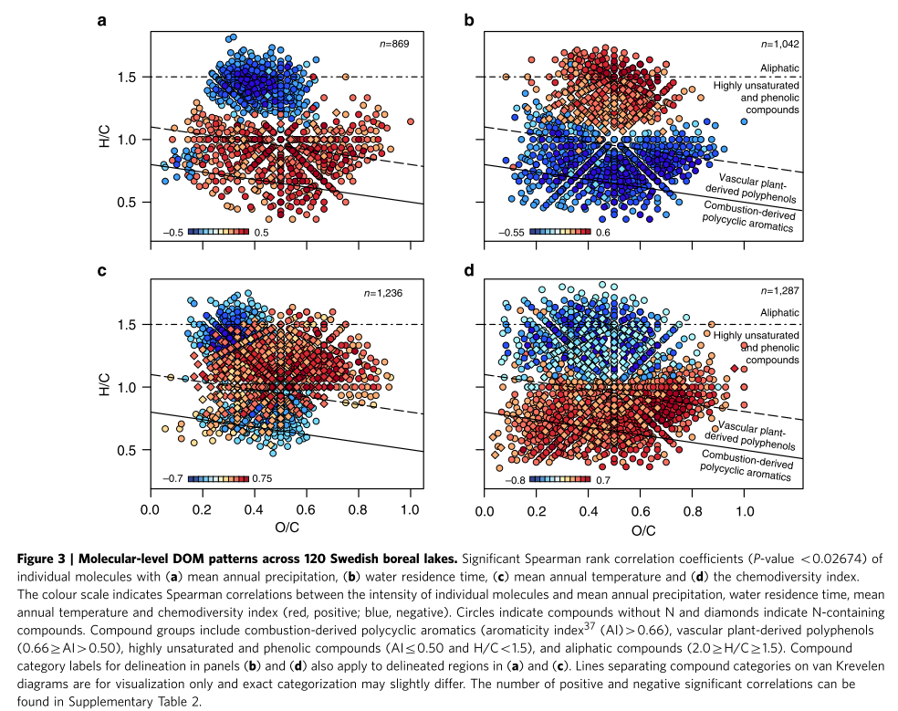
Typical Experimental Workflow – Data Analysis and Interpretation
Study of DOM composition of >100 Swedish lakes
Statistical analysis
Ordination, Correlation
Nat Commun 5, 3804 (2014). https://doi.org/10.1038/ncomms4804

Slide 19
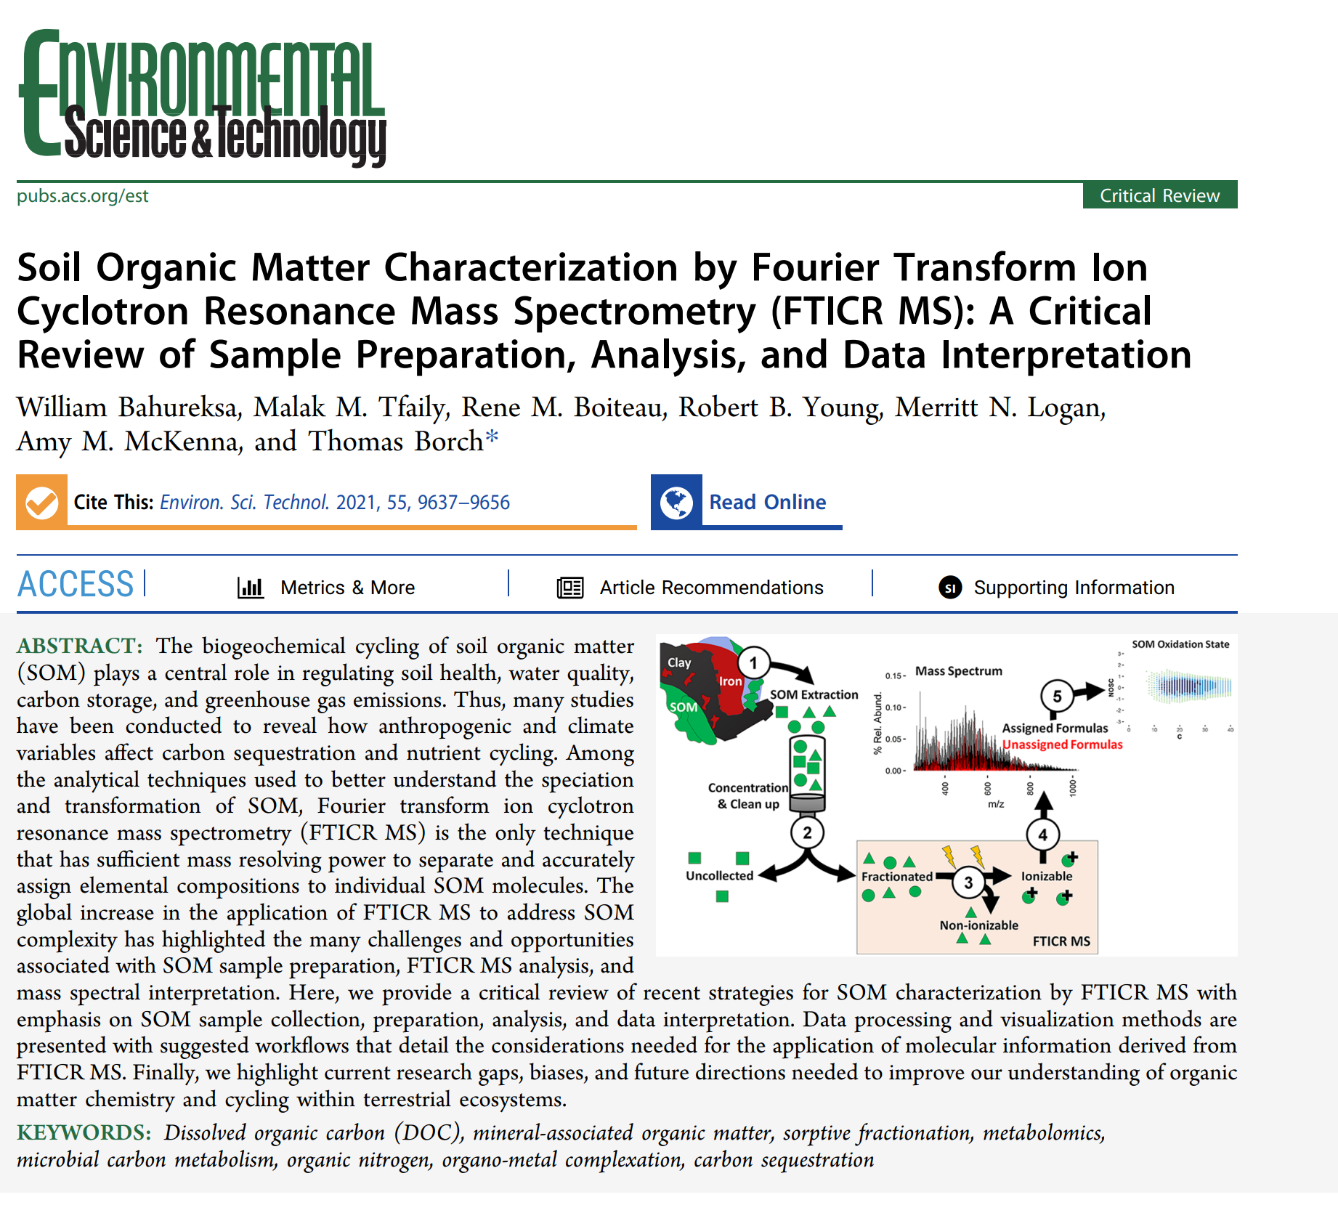
Recent Review!
Recent review covers key aspects of SOM characterization by FTICR MS experiment design!
Environ. Sci. Technol. 2021, 55, 14, 9637–9656
doi: 10.1021/acs.est.1c01135

Slide 20
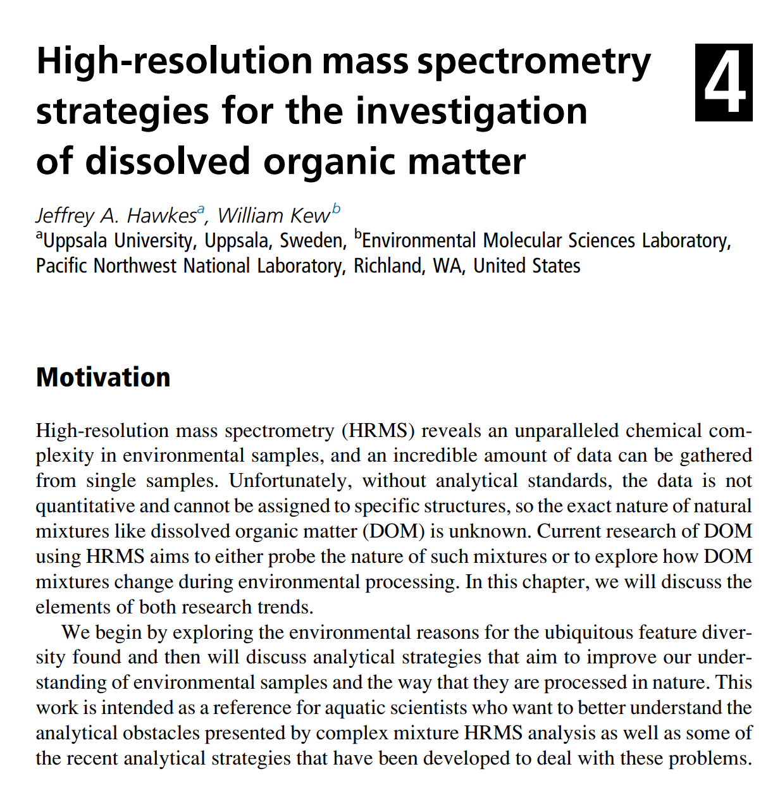
HRMS Strategies for DOM
2020 Book Chapter on DOM analysis by HRMS
Multidimensional Analytical Techniques in Environmental Research. https://doi.org/10.1016/B978-0-12-818896-5.00004-1
Covers state-of-the-art and future directions

Slide 21
Typical Experimental Workflow
Experiment Design
Sites
Sampling and Sample Preparation
Coring
FTICR MS Measurement
Ionization Mode
Raw Data Processing
Data Analysis and Interpretation
Conditions
Hypothesis
Sample Numbers
Replicates
Filtering
Wet or Dry Storage
Anoxic?
Desalting (Solid Phase Extraction SPE)
Solvent Extraction
Direct infusion or online LC?
Instruments
Acquisition Settings (Resolution, Sensitivity, Mass range)
Signal Processing
Peak Picking
Mass Recalibration
Formula Assignment
Spectrum Metrics
Stoichiometric Metrics
Visualization
Peak Intensity Data
Biogeochemical Contextualization

Slide 22
Case Studies

Slide 23

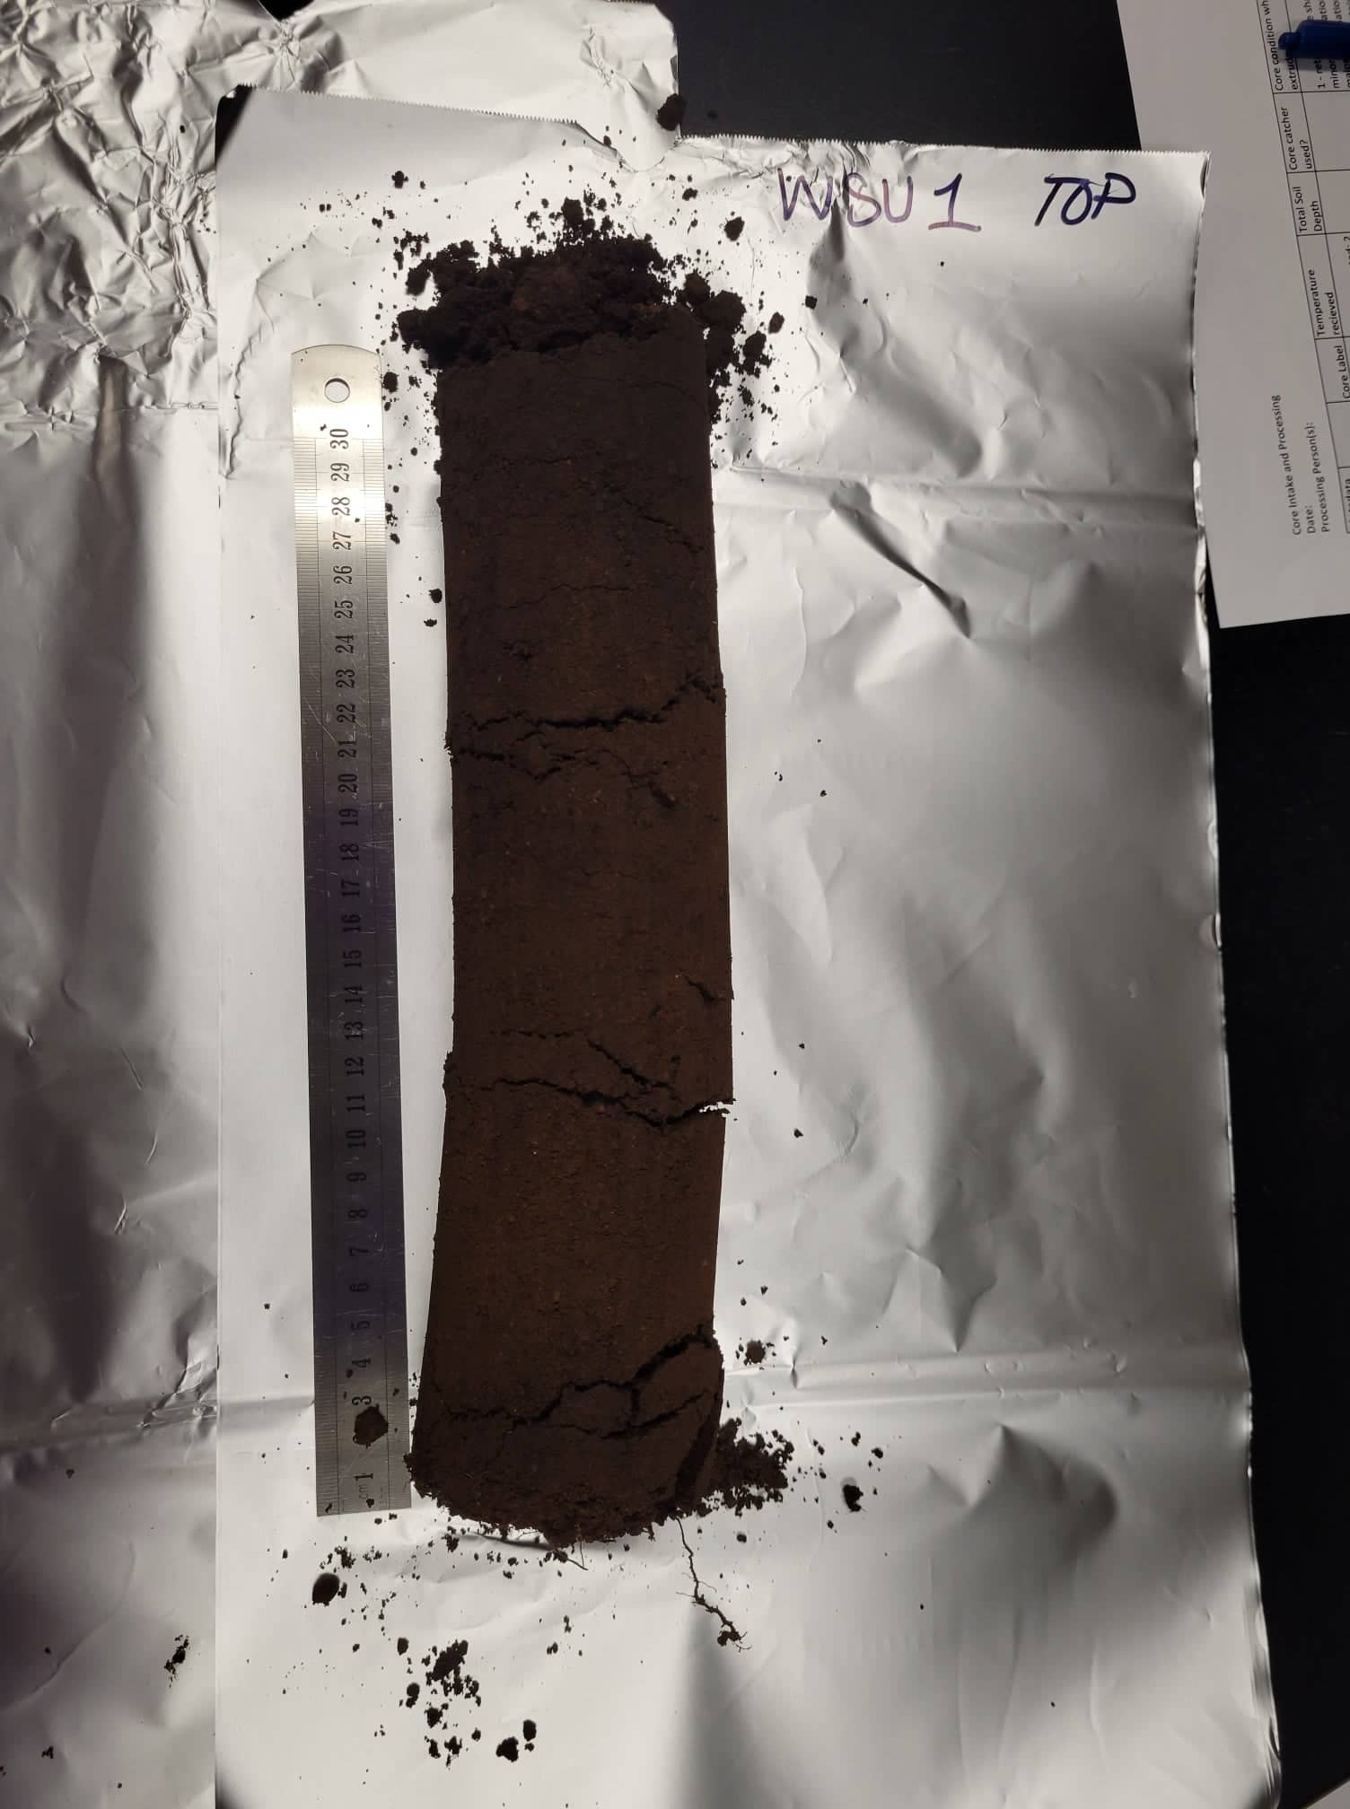
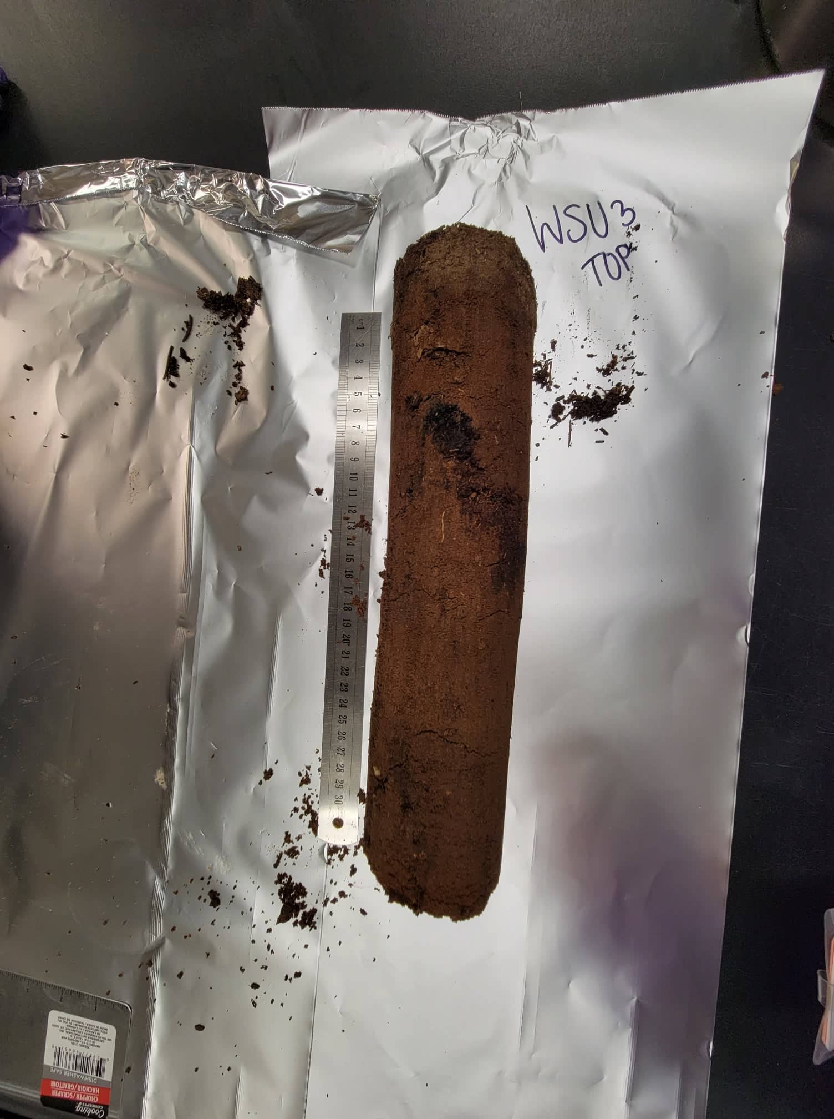
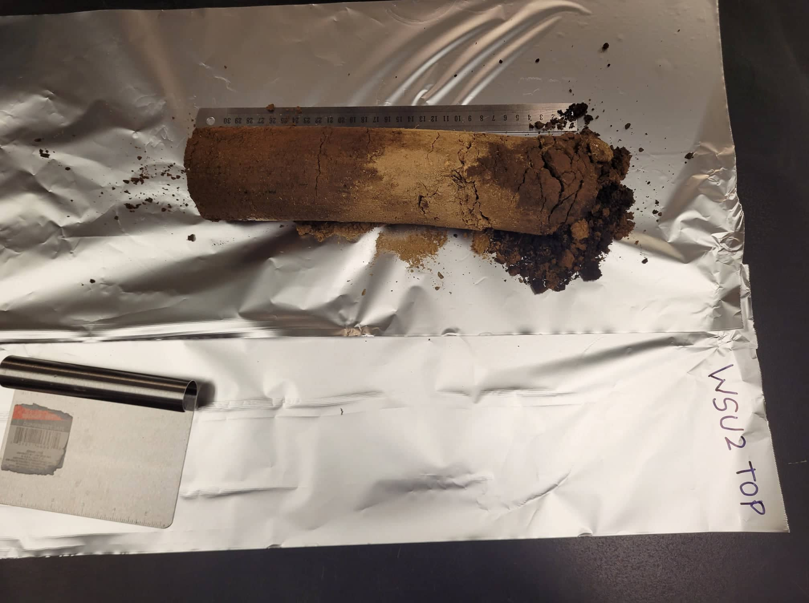
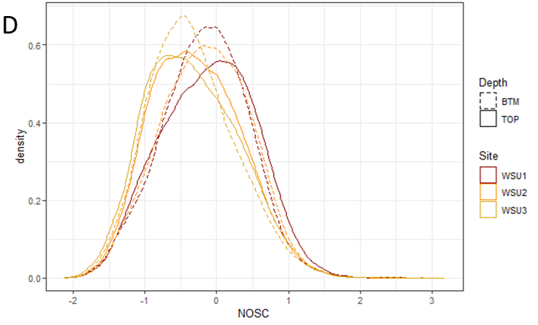
Case Study 1 – “1000 Soils” – the prequel to MONet
WSU1
WSU2
WSU3
Fire events shift soil NOSC values higher

Slide 24

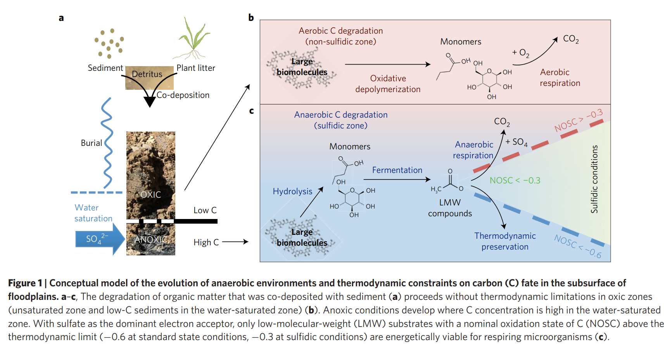
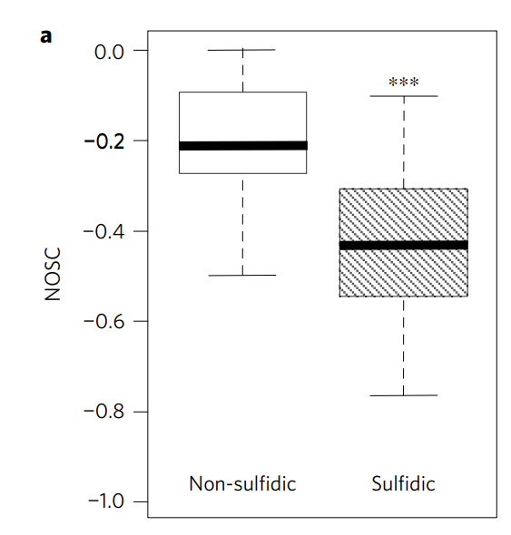
Case Study 2
Anoxic (sulfidic) vs oxic (non-sulfidic) floodplain sediments
FTICR informed thermodynamic analysis
Oxic conditions = more reduced C
Notes:
https://www.nature.com/articles/ngeo2940

Slide 25
Questions?
william.kew@pnnl.gov

Slide 26
Thank you

